Slide 1
STATISTICAL AND MACHINE LEARNING
GROUP PROJECT
MARIO SERRANO, SAI SUMANTH SRIPADA & OMAR MANTILLA

Slide 2


BUSINESS CASE
Credit RISK Predictive Model.
Notes:
Based on the credit data provided, there is a need to know whether a customer is able or not to repay the debt

Slide 3

BUSINESS CASE
Credit RISK Predictive Model.
Notes:
Based on the credit data provided, there is a need to know whether a customer is able or not to repay the debt

Slide 4
… DATASET CARACTERISTICS
 | TRAIN | TEST
OBSERVATIONS | 20,000 | 10,000
VARIABLES | 22+RV | 22
MISSING VALUES | 4,448 | 2.359
RV = default.payment.next.month

Slide 5
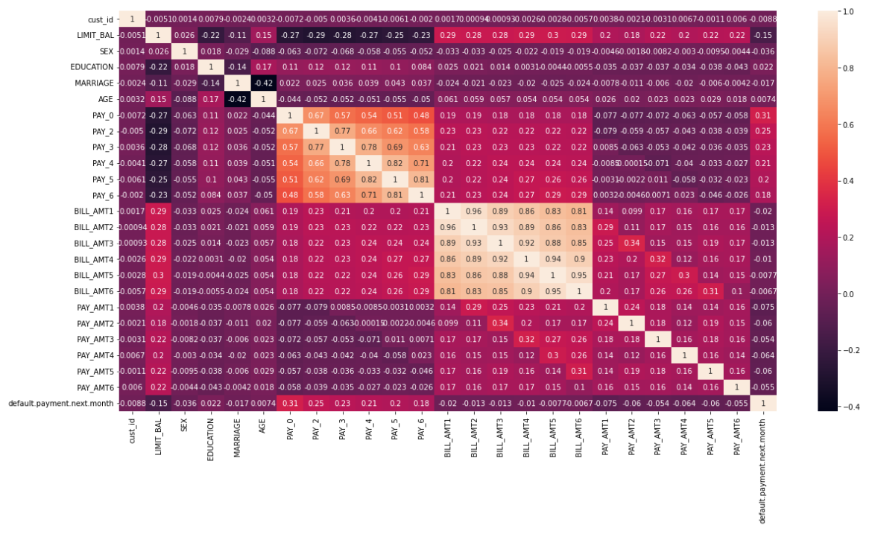
FEATURE CORRELATION

Slide 6
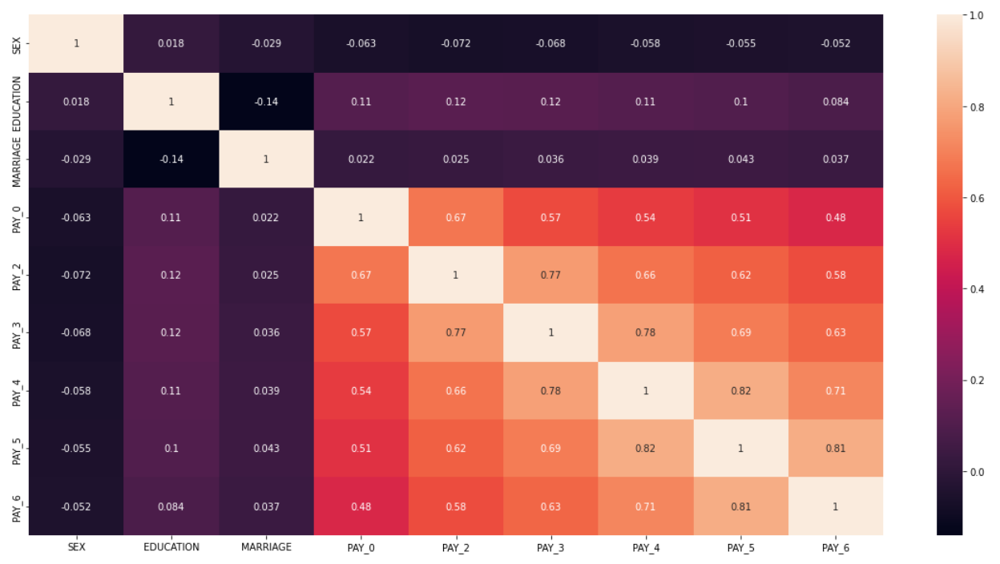
FEATURE CORRELATION (CATEGORICAL)

Slide 7
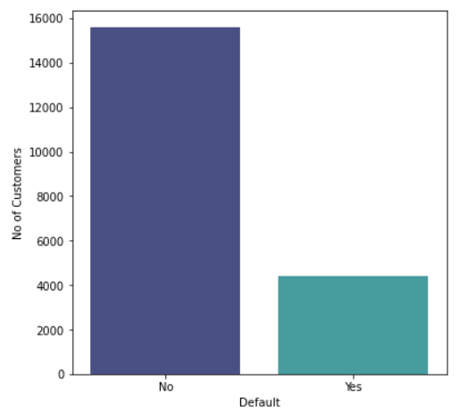
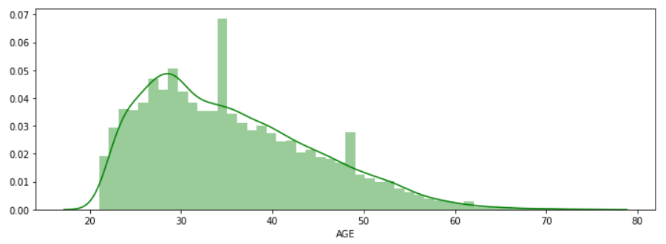
EXPLORATORY DATA ANALYSIS
Default Payment Distribution
Age Distribution
22% Default Rate

Slide 8
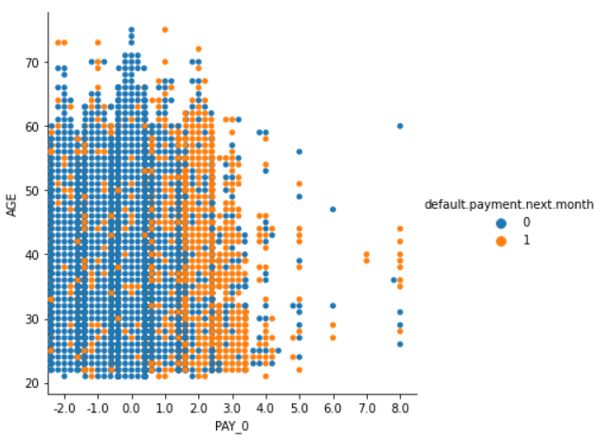
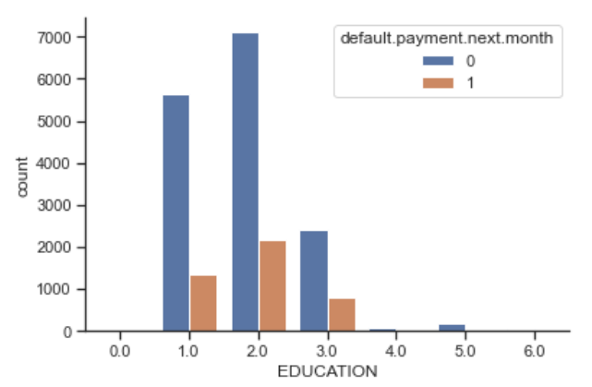
EXPLORATORY DATA ANALYSIS
Repayment Status (0), Age and Default Payment
Education and Default Payment

Slide 9
FIRST MODELS PERFOMANCE
Basic preprocessing: Filling missing values with zero
Most of the Models are overfitting with the initial setup
 | LOGISTIC REGRESSION | DECISION TREE | RAMDON FOREST | GB | XGB | LGBM | CAT BOOST
TRAIN ACCURACY | 0.779143 | 1.000000 | 0.999929 | 0.825357 | 0.918571 | 0.860643 | 0.865786
TEST ACCURACY | 0.779500 | 0.728167 | 0.813333 | 0.821667 | 0.808500 | 0.813167 | 0.818667
TRAIN AUC | 0.644924 | 1.000000 | 1.000000 | 0.816136 | 0.974415 | 0.914839 | 0.912650
TEST AUC | 0.643100 | 0.613967 | 0.743407 | 0.7662263 | 0.735523 | 0.754716 | 0.758674

Slide 10
01
02
03
ENCODING
ERROR CORRECTION
FEATURE ENGINEERING
DATA PRE-PROCESSING
04
FEATURE SELECTION
NUM variables using mean.
CAT variables using “Missing”
Encode CAT variables using integer values.
BOOLEAN in Int.
Create &/or remap new variables to feed our models
Fisher Scores ,Sequential Feature Selection and PCA
Notes:
TREAT categorical and numerical variables in different way for Nas.

Slide 11
FEATURE ENGINEERING & SELECTION
Created Age Group From the Age feature (Age_20 to Age_80).
PAY_0 to PAY_6 has high Mutual information, hence dropped them by creating PAY_Mean (Mean of 6 Features).
Encoded Categorical Variables using Ordinal Encoder.
Dummy variables for NA values.
Using Fisher Score, selected top 50 Variables.
Top 5,10,20 Features using Sequential Backward Feature Selection(Lasso).

Slide 12
MODEL PERFOMANCE AFTER DATA PROCESSING
 | LOGISTIC REGRESSION | DECISION TREE | RAMDON FOREST | GB | XGB | LGBM | CAT BOOST
TRAIN ACCURACY | 0.780000 | 0.794937 | 0.780062 | 0.802375 | 0.810438 | 0.801188 | 0.807813
TEST ACCURACY | 0.776250 | 0.796750 | 0.776250 | 0.799000 | 0.797250 | 0.798750 | 0.796250
TRAIN AUC | 0.643489 | 0.711228 | 0.737506 | 0.768300 | 0.790052 | 0.767506 | 0.778059
TEST AUC | 0.651771 | 0.710614 | 0.730662 | 0.754068 | 0.751265 | 0.752106 | 0.755061
Notes:
Cross Validation AUC is 0.753

Slide 13
MODEL PERFOMANCE NEURAL NETWORK
 | BEST MODEL PARAMETERS* | TRAIN SCORE (AUC) | TEST SCORE (AUC)
BASIC PROCESSING | Activation: sigmoid, Batch Size: 25, Epochs: 100, Optimizer: RMSprop, Hidden Layers: 3, Nodes per Layer: 21 | 0.585293 | 0.584804
PROCESSED DATA | Activation: sigmoid, Batch Size: 20, Epochs: 300, Optimizer: adam, Hidden Layers: 3, Nodes per Layer: 25 | 0.75902 | 0.757848
*Obtained with GridSearchCV

Slide 14
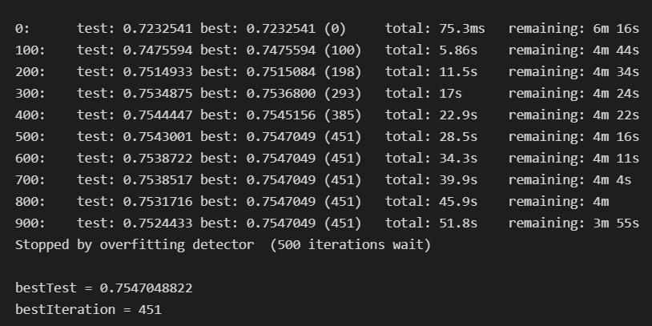
CATBOOST – Finding Best Parameters
CATBOOST is the Best performing Model and below is the tuning parameters we tried through Manual Tuning.

Slide 15
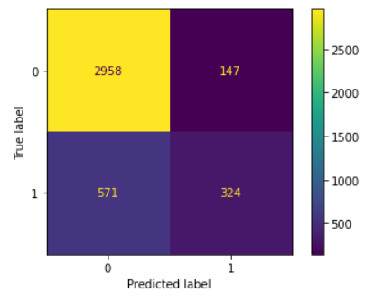
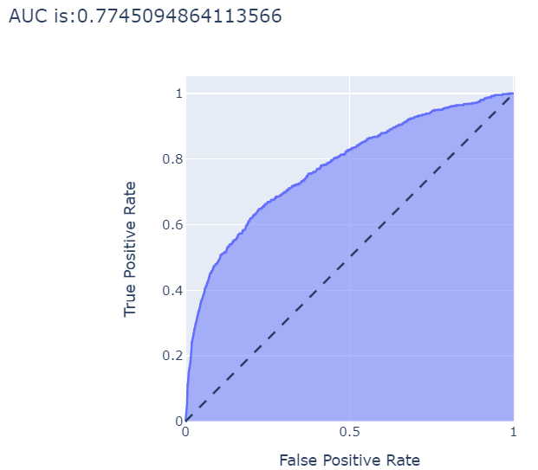
MODEL EVALUATION - CATBOOST
Confusion Matrix
ROC Curve
Train AUC : 0.7979
Test AUC : 0.7745
Kaggle : 0.7891

Slide 16
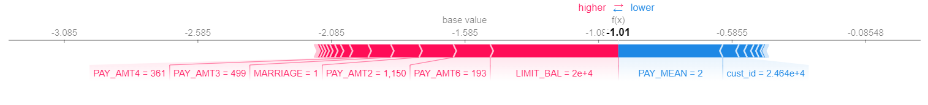
MODEL INTERPRETATION - CATBOOST
CATBOOST Model is interpreted using SHAP.
Features in the Red are the features pushing the Model performance Higher
Features in the blue are Pushing the Model Performance Lower.

Slide 17
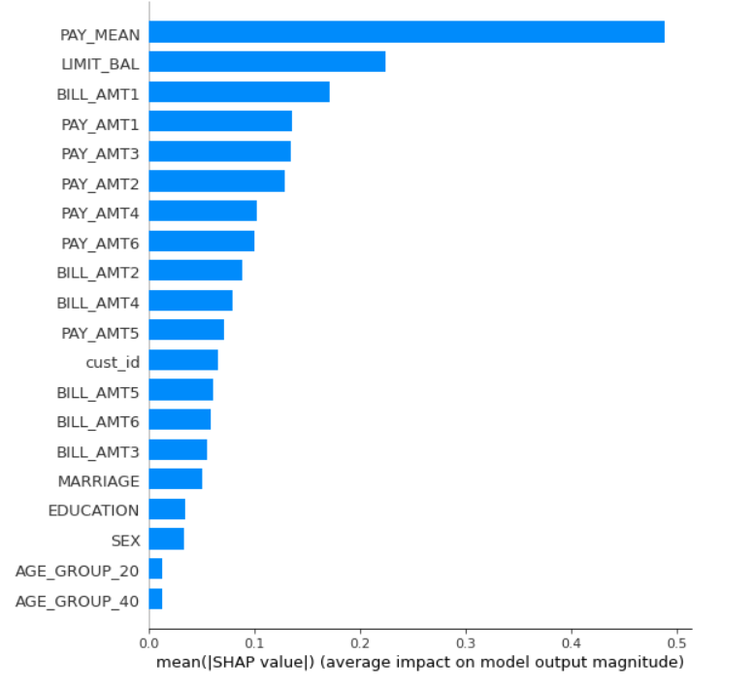
FEATURE IMPORTANCE (SHAP) – CATBOOST
Feature Importance based on the SHAP Values of each feature.
Based on SHAP value we can see the impact of all the features on the Model output.
Pay_mean has the Highest impact on the Model output.

Slide 18
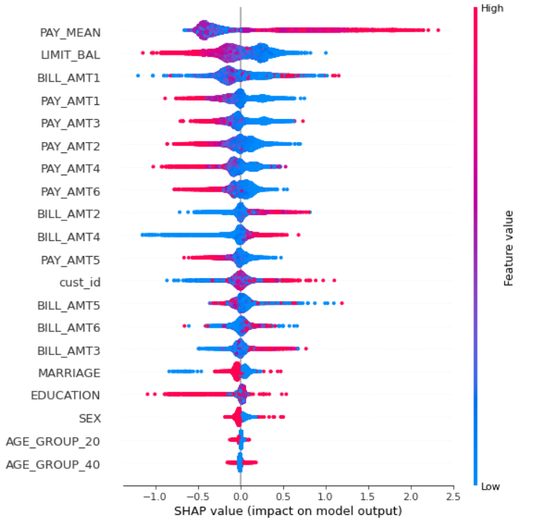
MODEL INTERPRETATION – Feature Importance
Feature Importance based on the SHAP Values of each feature.
Based on SHAP value we can see the impact of all the features on the Model output.
Pay_mean has the Highest impact on the Model output.

Slide 19
EXPERIMENTAL SETUP
Scaled the Data using Standard Scaling and Benchmarked Performance For all the Models
 | LOGISTIC REGRESSION | DECISION TREE | RAMDON FOREST | GB | XGB | LGBM | CAT BOOST
TRAIN ACCURACY | 0.807000 | 0.818357 | 0.798000 | 0.822786 | 0.826143 | 0.821643 | 0.823286
TEST ACCURACY | 0.808167 | 0.814167 | 0.796333 | 0.816167 | 0.817500 | 0.816667 | 0.815000
TRAIN AUC | 0.712919 | 0.685925 | 0.765877 | 0.793401 | 0.815052 | 0.793420 | 0.804664
TEST AUC | 0.708885 | 0.682644 | 0.755447 | 0.765802 | 0.767195 | 0.767507 | 0.768757

Slide 20
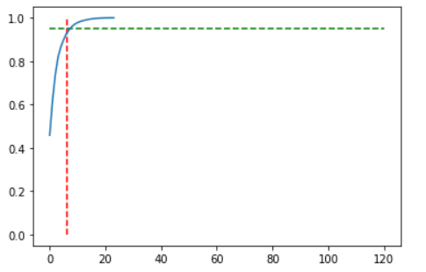
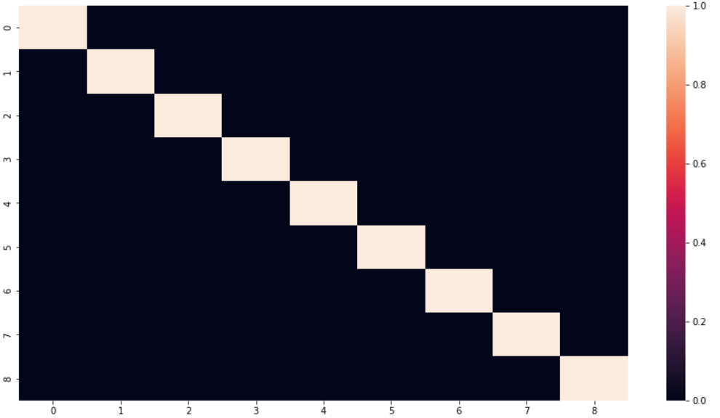
PCA
Number of Components
Correlation Between Components
Performance of the Models was decreased after doing PCA.

Slide 21
SMOTE – Oversampling
As the Classification is imbalanced, we tried oversampling the defaulters using SMOTE.
Proportion of defaults and no defaults in Oversampled data is 0.5
Number of defaults and no defaults in oversampled data is 15586
 | LOGISTIC REGRESSION | DECISION TREE | RAMDON FOREST | GB | XGB | LGBM | CAT BOOST
TRAIN ACCURACY | 0.807000 | 0.729759 | 0.786983 | 0.863416 | 0.878494 | 0.862774 | 0.874363
TEST ACCURACY | 0.808167 | 0.729912 | 0.788132 | 0.860626 | 0.868966 | 0.861427 | 0.867362
TRAIN AUC | 0.712919 | 0.792266 | 0.862085 | 0.927941 | 0.942674 | 0.927572 | 0.937644
TEST AUC | 0.708885 | 0.792641 | 0.864572 | 0.925603 | 0.928740 | 0.925075 | 0.930715

Slide 22


DEFAULT CUSTOMER PROFILE
Avg Limit Balance = ~13k
Average Age of defaulters = 35.6
Avg Bill amount = 43K
Avg payment amount = 3K
Single Females in University

Slide 23

CONCLUSIONS
Tree Based Models performs the best for this business case.
The data processing techniques influence the model performance.
Hyperparameter Tuning and the Feature engineering helps the Model to make more accurate Predictions.
Best performing model was CatBoost.

Slide 24

QUESTIONS

Slide 25
REFERENCES:
Data Pipeline from the Class.
https://medium.com/analytics-vidhya/catboost-101-fb2fdc3398f3
https://machinelearningmastery.com/smote-oversampling-for-imbalanced-classification/
https://shap.readthedocs.io/en/latest/example_notebooks/tabular_examples/tree_based_models/Catboost%20tutorial.html
https://scikit-learn.org/stable/modules/generated/sklearn.feature_selection.RFE.html

